Slide 1
Mobile Application Development
David Drohan (ddrohan@wit.ie)

Slide 2
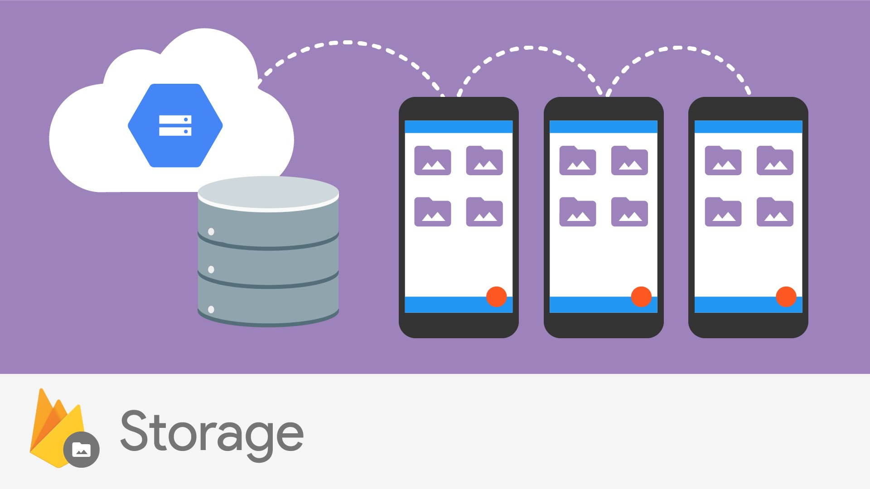

Slide 3
Overview (Official)
Cloud Storage for Firebase lets you upload and share user generated content, such as images and video, which allows you to build rich media content into your apps.
Your data is stored in a Google Cloud Storage bucket, an exabyte scale object storage solution with high availability and global redundancy.
Cloud Storage lets you securely upload these files directly from mobile devices and web browsers, handling spotty networks with ease.

Slide 4
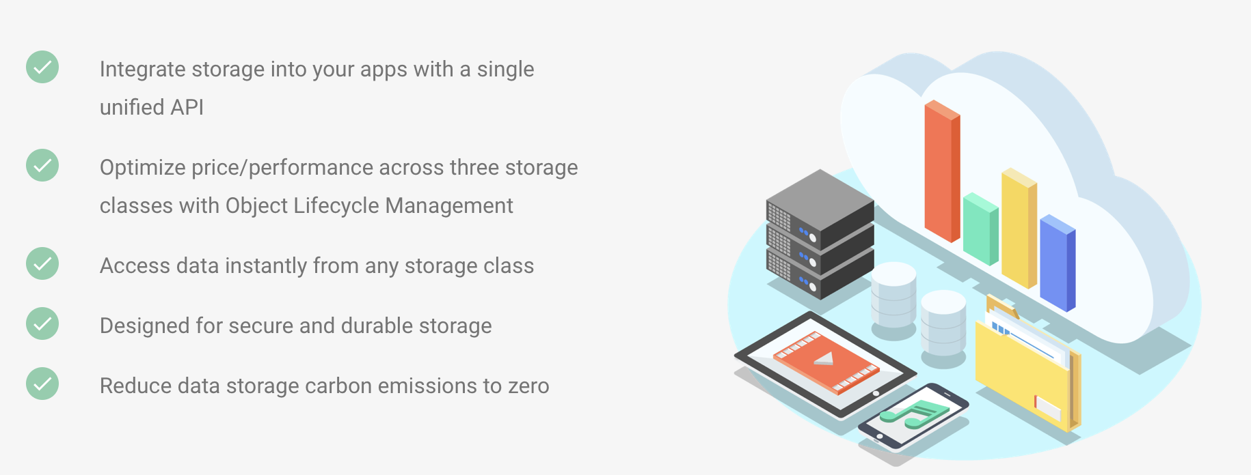
Key Features (Official)

Slide 5

Get Started with Cloud Storage on Android
https://firebase.google.com/docs/storage/android/start

Slide 6
Firebase Cloud Storage

Slide 7
1. Create your Firebase Project (set up in previous labs)

Slide 8
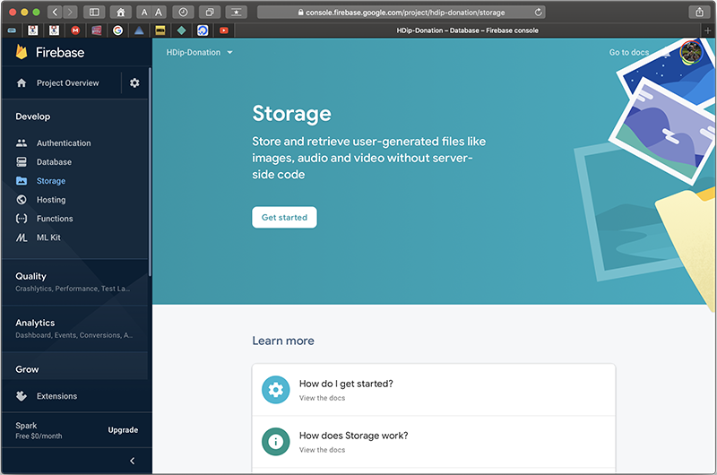
2. Setup your Storage Bucket

Slide 9
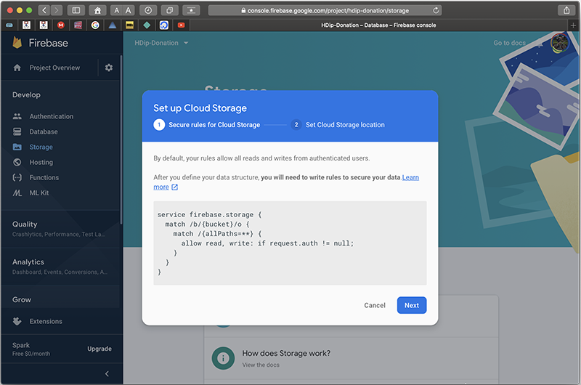
2. Setup your Storage Bucket

Slide 10
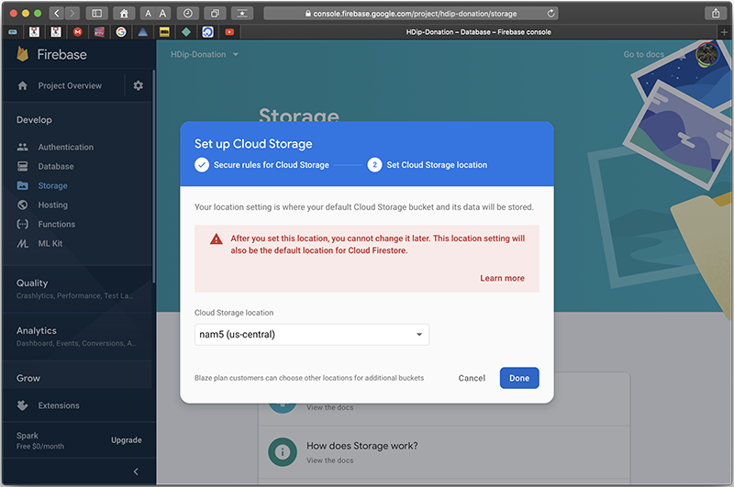
2. Setup your Storage Bucket

Slide 11
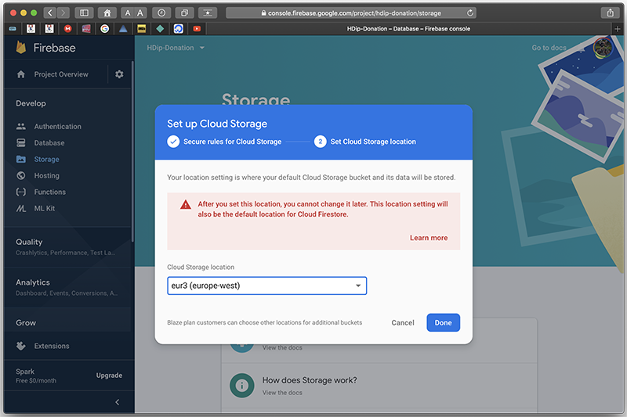
2. Setup your Storage Bucket

Slide 12
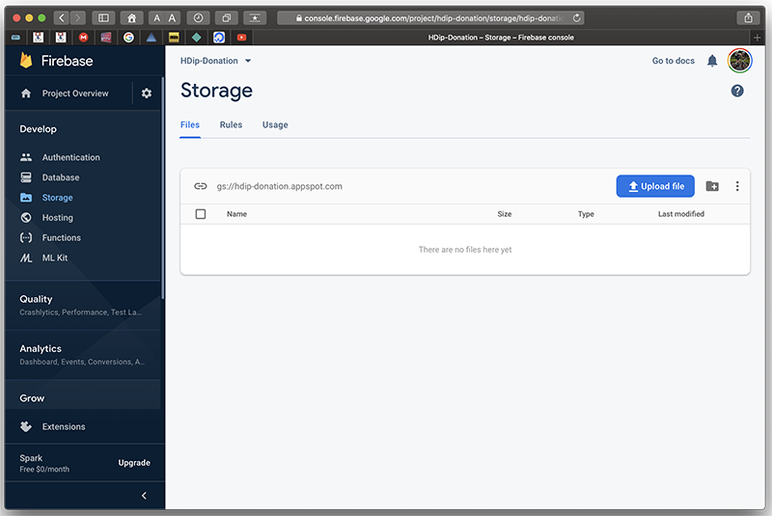
2. Setup your Storage Bucket

Slide 13
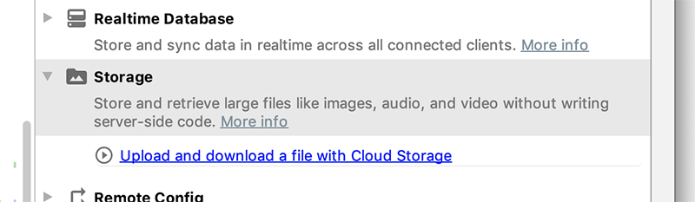
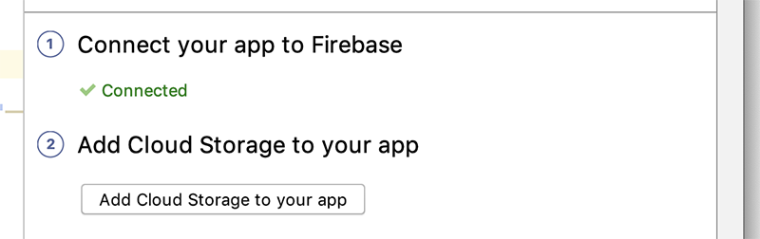
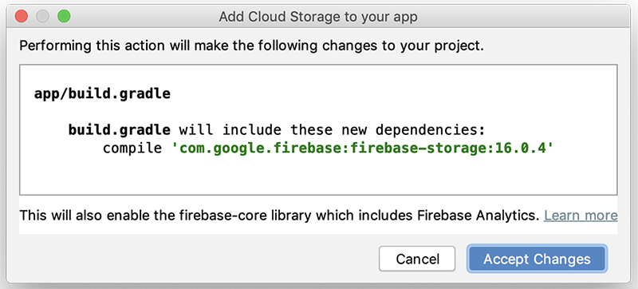
3. Configure Your App
implementation 'com.google.firebase:firebase-storage:19.1.0'

Slide 14
3. Configure Your App – IMPORTANT!
implementation 'com.google.firebase:firebase-storage:19.1.0'

Slide 15
4. Start Uploading/Downloading your Files
https://github.com/firebase/quickstart-android

Slide 16
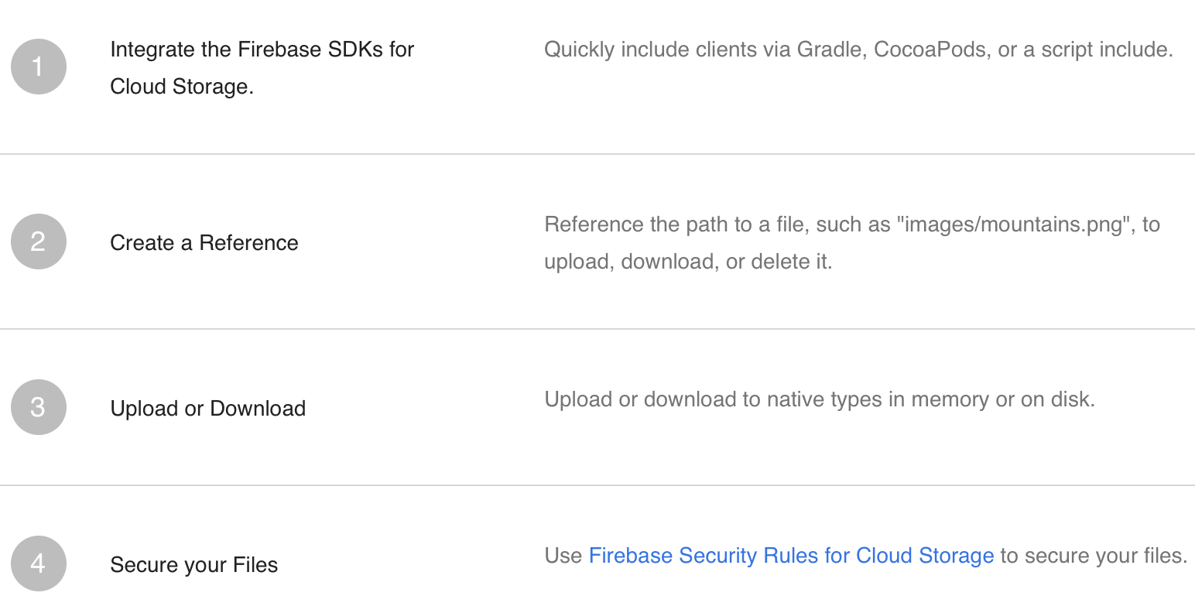
Implementation Path (Official)

Slide 17
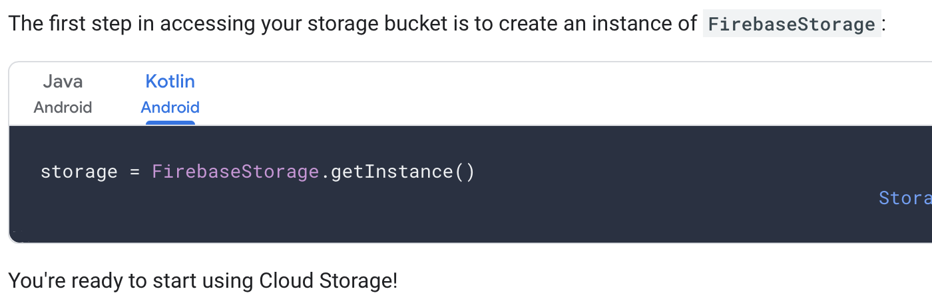
4. Get a Reference to your Bucket

Slide 18
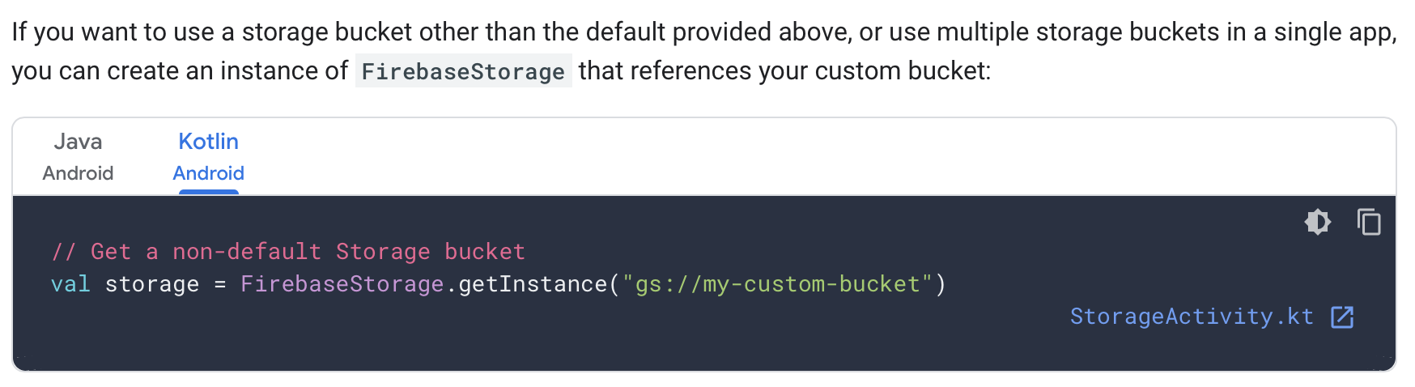
4. Get a Reference to your Bucket

Slide 19
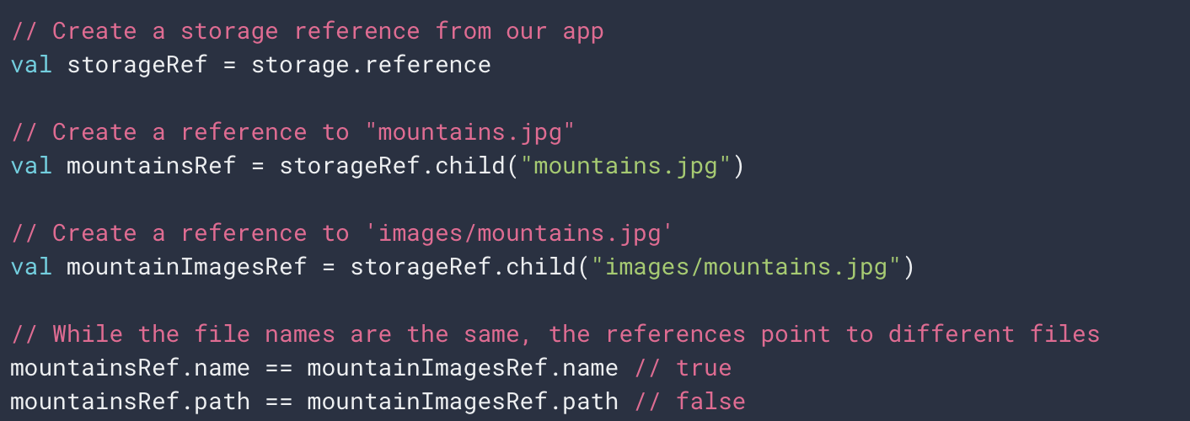
4. Uploading Files

Slide 20
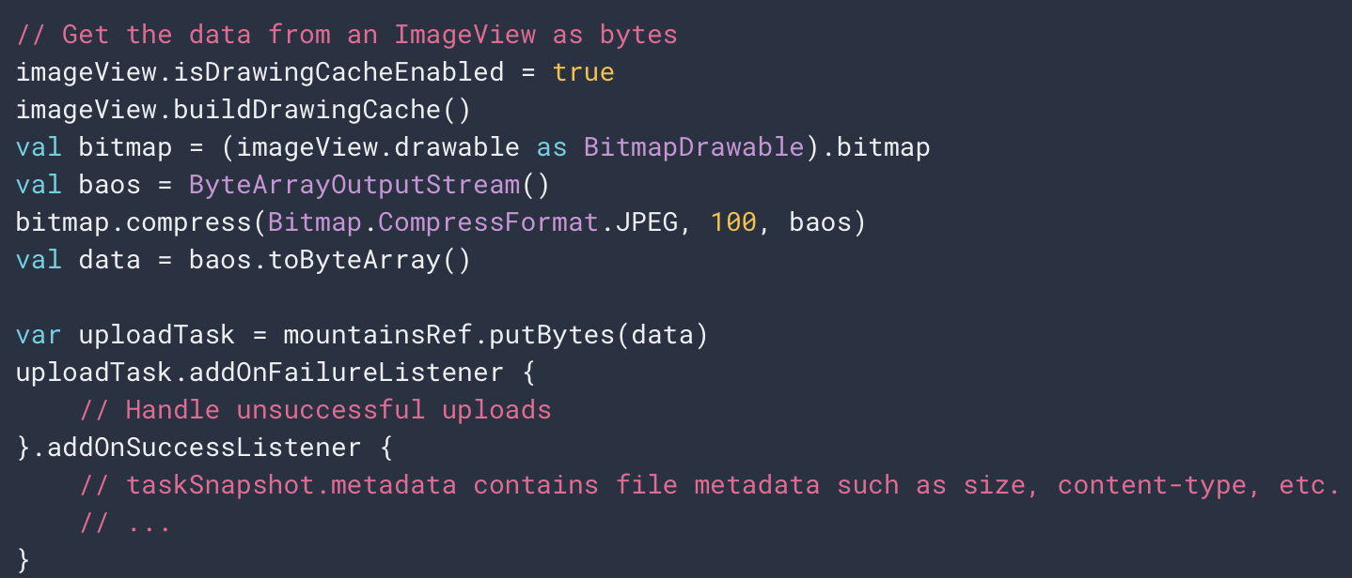
4. Uploading Files (data in memory)

Slide 21
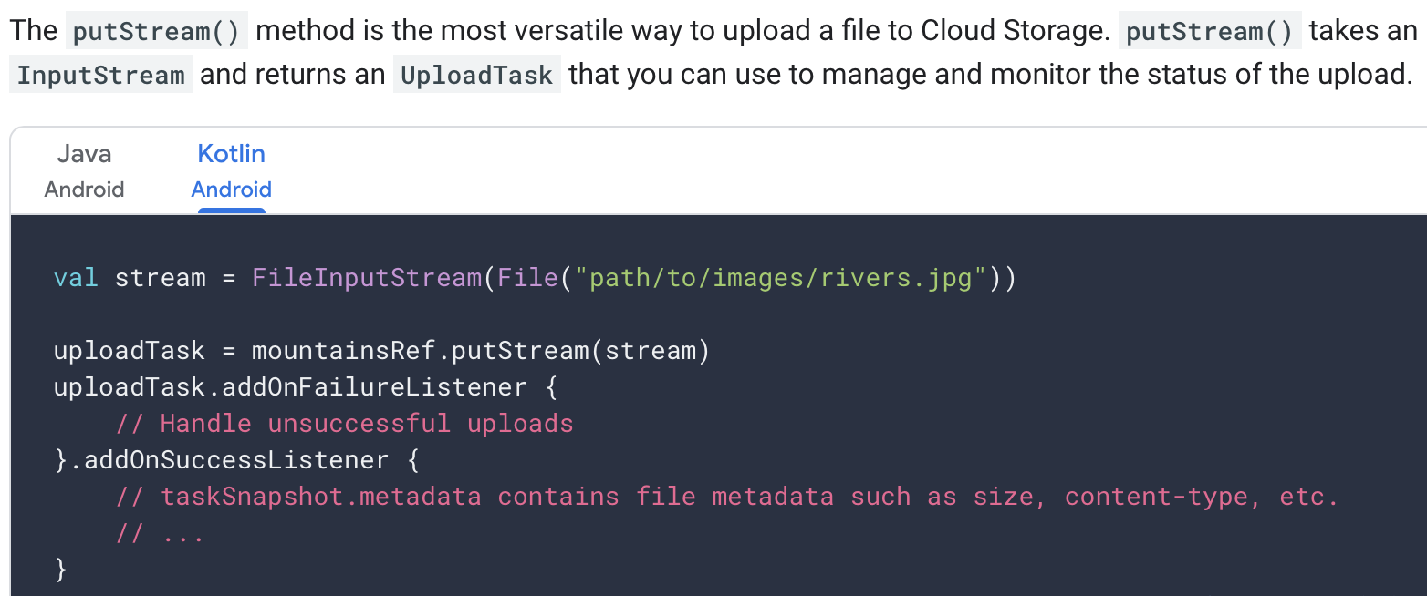
4. Uploading Files (from a stream)

Slide 22
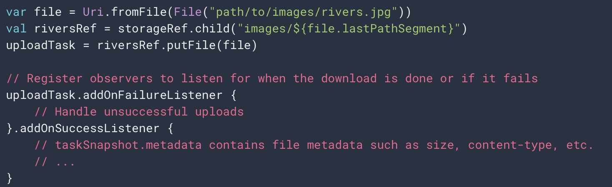
4. Uploading Files (from a local file)

Slide 23
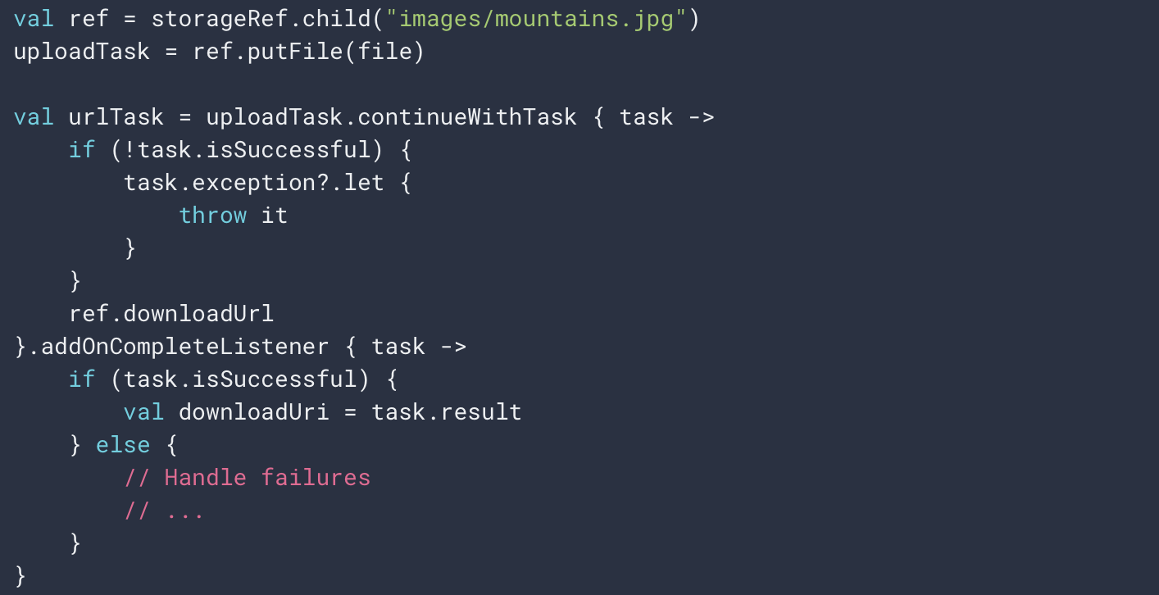
4. Uploading Files (get your download URL)

Slide 24
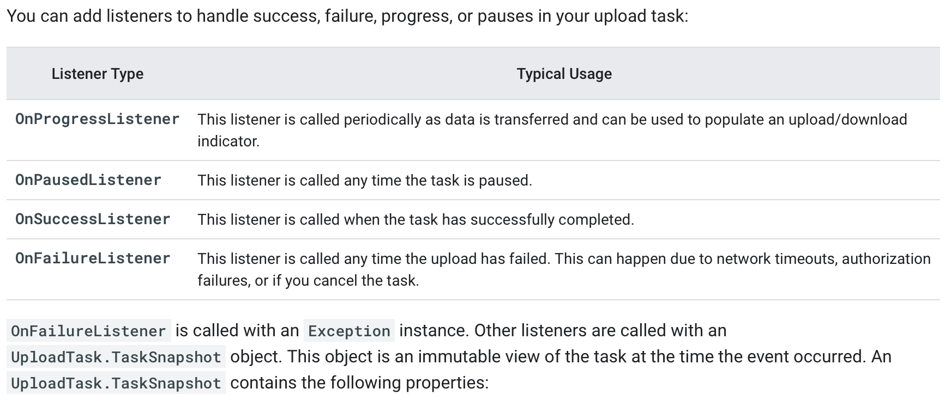
4. Uploading Files (monitoring progress)

Slide 25
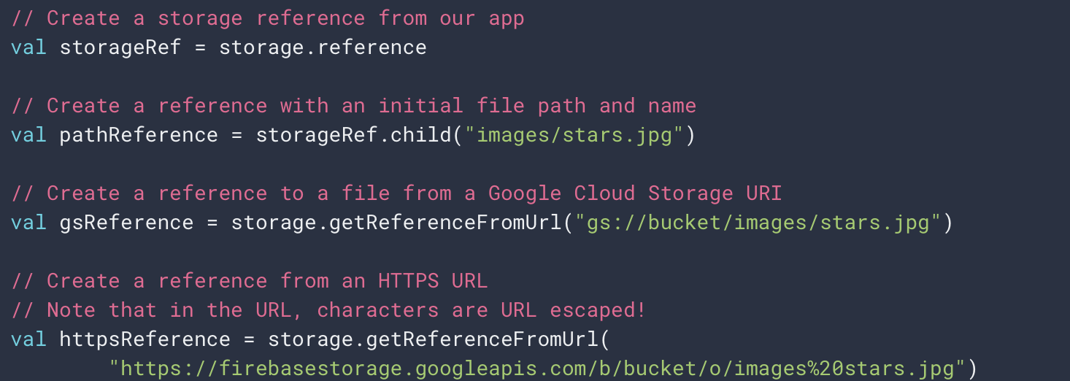
4. Downloading Files (get a reference)

Slide 26
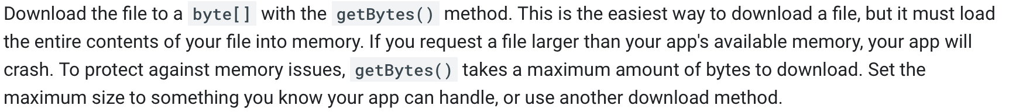
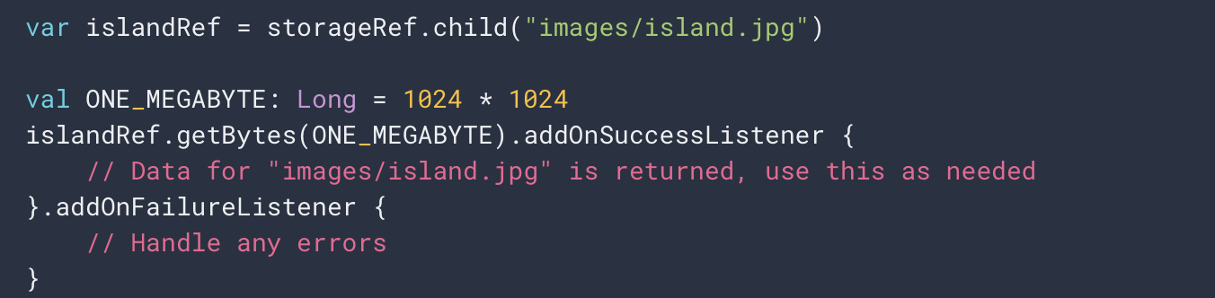
4. Downloading Files (into memory)

Slide 27
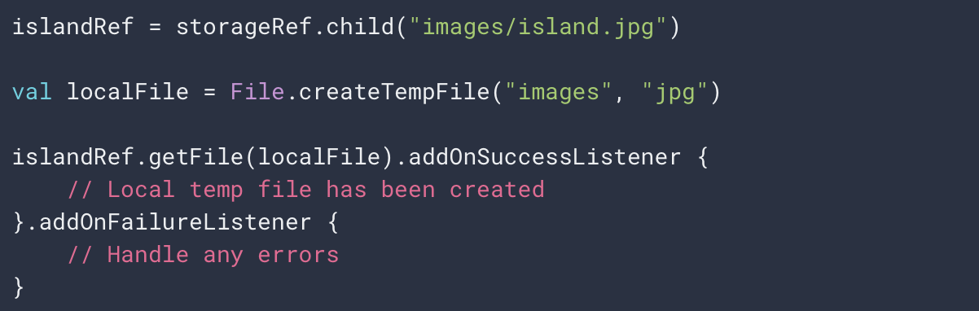
4. Downloading Files (to a local file)

Slide 28
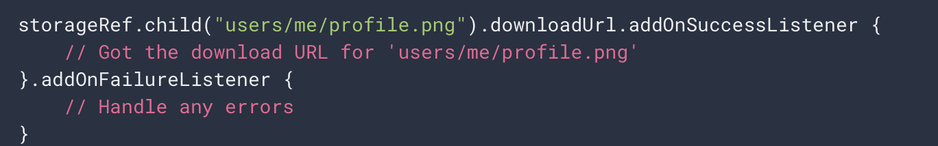
4. Downloading Files (via URL)

Slide 29
We’ll look at how we work with files (Images) saved to Cloud Storage in the Code walkthrough and the Lab

Slide 30
References
https://console.firebase.google.com/
https://firebase.google.com/
https://github.com/firebase/quickstart-android
https://firebase.google.com/docs/storage/android/start
https://firebase.google.com/docs/storage/android/upload-files

Slide 31


